Slide 1
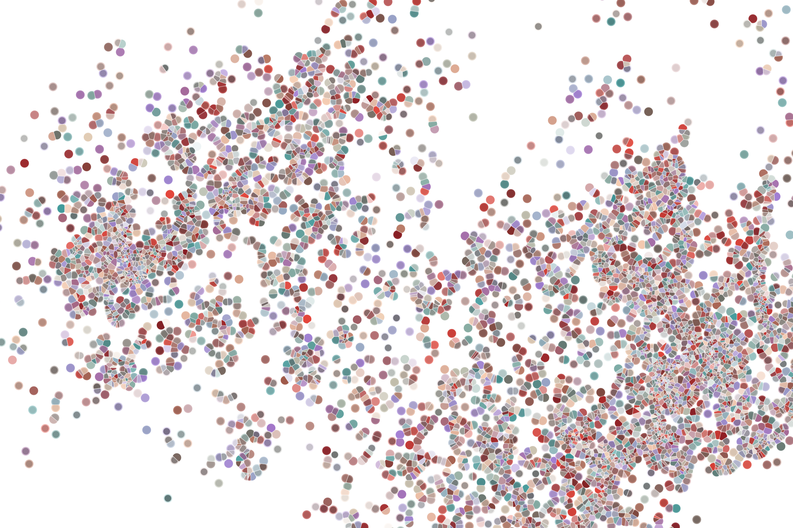
Lecture 4 Identifying cell populations
Physalia course 2022 — Single-cell RNA-seq with R/Bioconductor
Instructors: Orr Ashenberg, Arnav Mehta & Jacques Serizay
Notes:
Hello everybody and thank you for attending my presentation. I am going to talk about the project I recently started working on in the Spassky and Koszul labs, both located in Paris. This project focuses on the unusual cooption of the mitotic machinery to drive, not cell division but cell differentiation.

Slide 2

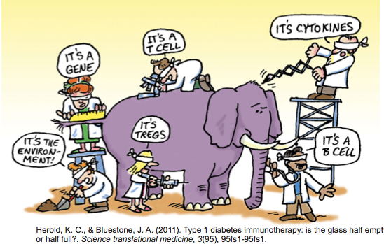
How Do We Define Cellular Identity?
A cell participates in multiple processes/contexts.
2
Notes:
I would like to expand these observations to in vivo data. I also want to check what happens in terms of transcriptional dynamics in cells where Cyclin O, a key non-canonical cyclin involved in MCC diff., is knocked-out.

Slide 3

Analysis workflow
Pre-Processing
Clustering
Biology
Expression Matrix
(GENES x CELLS)
1. Identify
Variable Genes
5. Differentially Expressed Genes
Filter Cells /
Quality Control
2. Dimensionality Reduction
6. Assigning
Cell Type
Normalization
3. Clustering
7. Functional Annotation
4. Explore (known)
marker genes
Notes:
I would like to expand these observations to in vivo data. I also want to check what happens in terms of transcriptional dynamics in cells where Cyclin O, a key non-canonical cyclin involved in MCC diff., is knocked-out.

Slide 4
Analysis workflow
Pre-Processing
Clustering
Biology
Expression Matrix
(GENES x CELLS)
1. Identify
Variable Genes
5. Differentially Expressed Genes
Filter Cells /
Quality Control
2. Dimensionality Reduction
6. Assigning
Cell Type
Normalization
3. Clustering
7. Functional Annotation
4. Explore (known)
marker genes
Notes:
I would like to expand these observations to in vivo data. I also want to check what happens in terms of transcriptional dynamics in cells where Cyclin O, a key non-canonical cyclin involved in MCC diff., is knocked-out.

Slide 5
Dimensional reduction in scRNAseq studies
High-dimensional data can be difficult to interpret.
One approach to simplification is to assume that the data of interest lies within lower-dimensional space. If the data of interest is of low enough dimension, the data can be visualised in the low-dimensional space.
A scRNA seq starts with many measurements (features, genes).
We want to reduce it to fewer informative dimensions.
We have starting doing this by using only highly variable genes.
We can further reduce dimension with linear or non-linear approaches.
5
Notes:
I would like to expand these observations to in vivo data. I also want to check what happens in terms of transcriptional dynamics in cells where Cyclin O, a key non-canonical cyclin involved in MCC diff., is knocked-out.

Slide 6
Dimensional reduction in scRNAseq studies
High-dimensional data can be difficult to interpret.
One approach to simplification is to assume that the data of interest lies within lower-dimensional space. If the data of interest is of low enough dimension, the data can be visualised in the low-dimensional space.
Common Techniques
Principal Component Analysis (PCA)
Independent Component Analysis (ICA)
Multidimensional Scaling (MDS)
Non-negative Matrix Factorization (NMF)
Probabilistic Modeling (e.g. Latent Dirichlet Allocation - LDA)
6
Notes:
I would like to expand these observations to in vivo data. I also want to check what happens in terms of transcriptional dynamics in cells where Cyclin O, a key non-canonical cyclin involved in MCC diff., is knocked-out.

Slide 7
Principal Component Analysis
PCA is a dimensionality reduction method that transforms a set of features into a set of linearly uncorrelated variables called principal components
1,000s cells
1,000s cells
10,000 genes
(few) Principal components
https://stats.stackexchange.com/questions/2691/making-sense-of-principal-component-analysis-eigenvectors-eigenvalues
7
Notes:
I would like to expand these observations to in vivo data. I also want to check what happens in terms of transcriptional dynamics in cells where Cyclin O, a key non-canonical cyclin involved in MCC diff., is knocked-out.

Slide 8

Principal Component Analysis
PCA is a dimensionality reduction method that transforms a set of features into a set of linearly uncorrelated variables called principal components
The first principal component contains the most variance, and each component after contains as much variance while still being orthogonal to other components
https://stats.stackexchange.com/questions/2691/making-sense-of-principal-component-analysis-eigenvectors-eigenvalues
8
Notes:
I would like to expand these observations to in vivo data. I also want to check what happens in terms of transcriptional dynamics in cells where Cyclin O, a key non-canonical cyclin involved in MCC diff., is knocked-out.

Slide 9
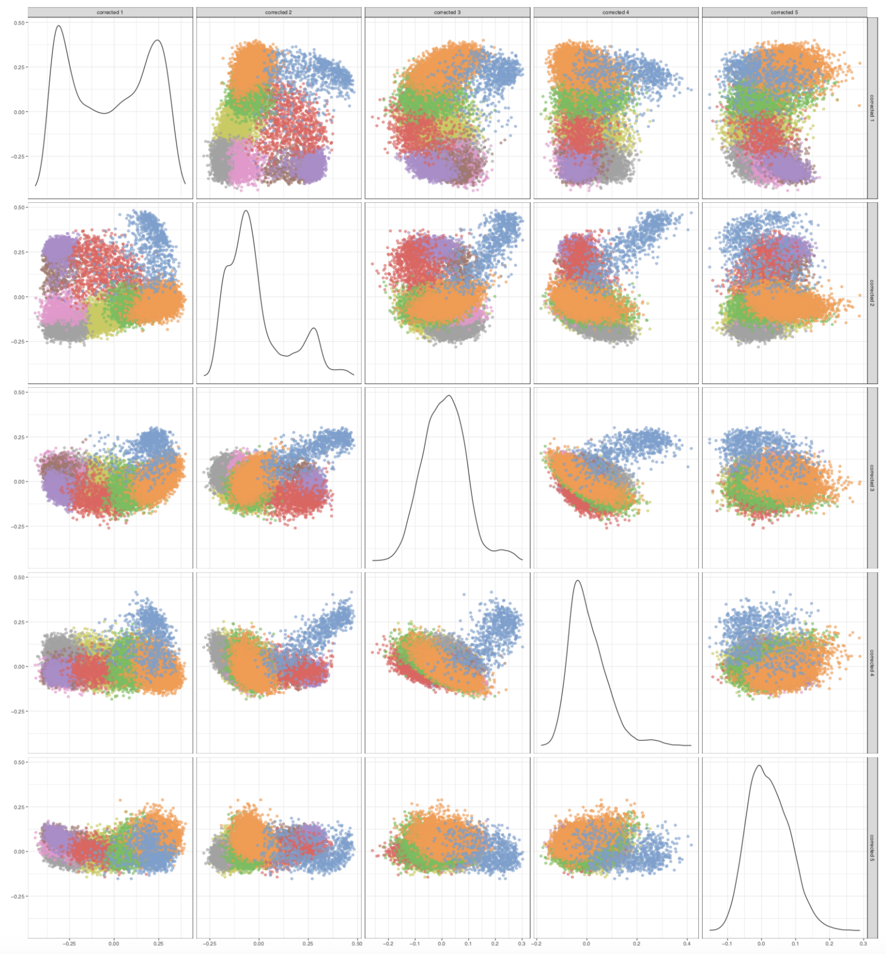
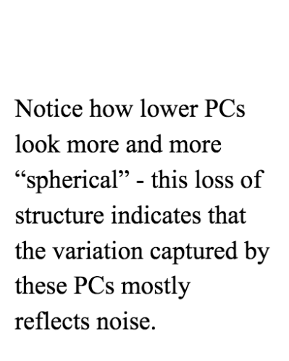
Principal Component Analysis: assessing lower dimensions
9
Notes:
I would like to expand these observations to in vivo data. I also want to check what happens in terms of transcriptional dynamics in cells where Cyclin O, a key non-canonical cyclin involved in MCC diff., is knocked-out.

Slide 10
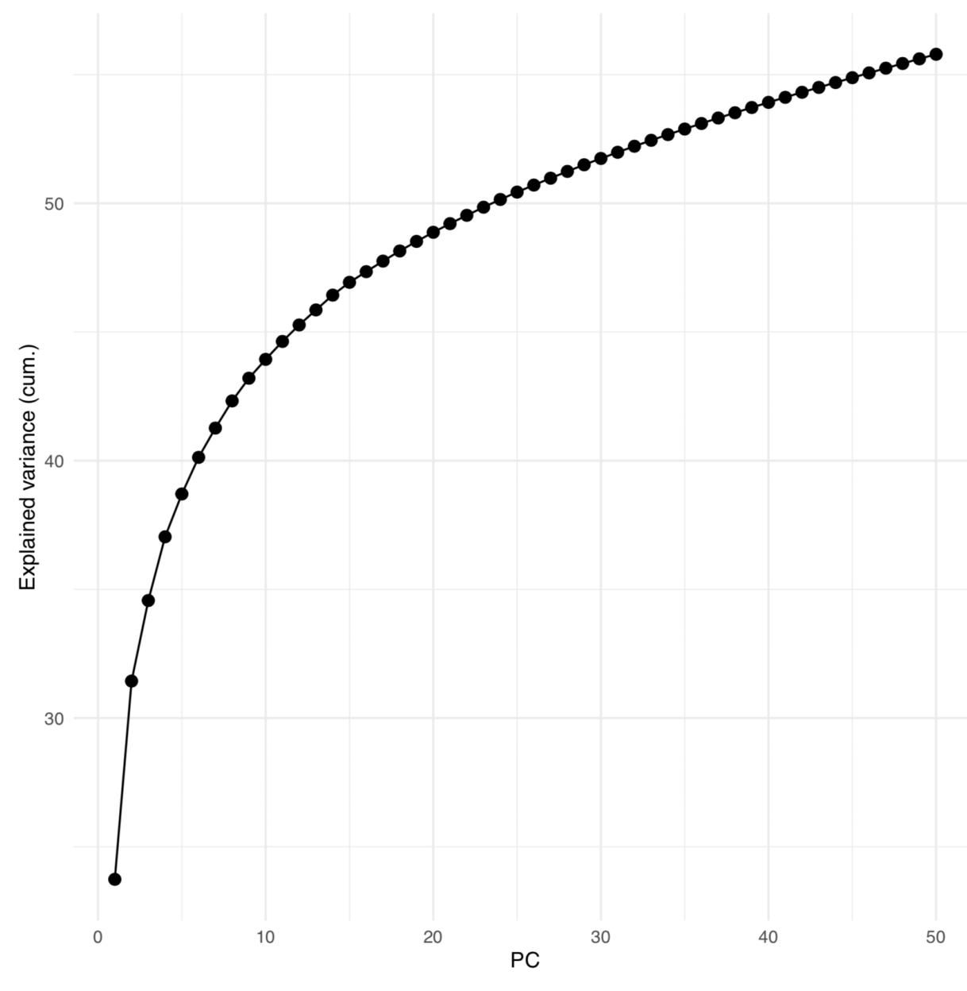
Principal Component Analysis: assessing lower dimensions
10
Notes:
I would like to expand these observations to in vivo data. I also want to check what happens in terms of transcriptional dynamics in cells where Cyclin O, a key non-canonical cyclin involved in MCC diff., is knocked-out.

Slide 11
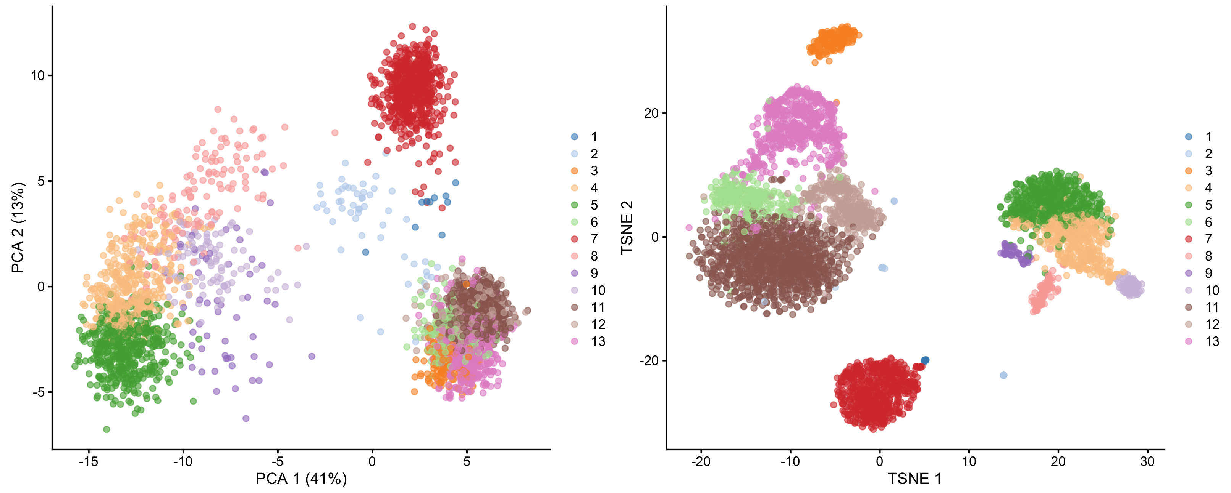
Going further: non-linear dimensional reductions
In a t-SNE projection, similar objects (cells) are modeled by nearby two-(three)dimensional points and dissimilar objects are modeled by distant points with high probability.
1,000s cells
1,000s cells
10,000 genes
(few) Principal components
11
Notes:
I would like to expand these observations to in vivo data. I also want to check what happens in terms of transcriptional dynamics in cells where Cyclin O, a key non-canonical cyclin involved in MCC diff., is knocked-out.

Slide 12
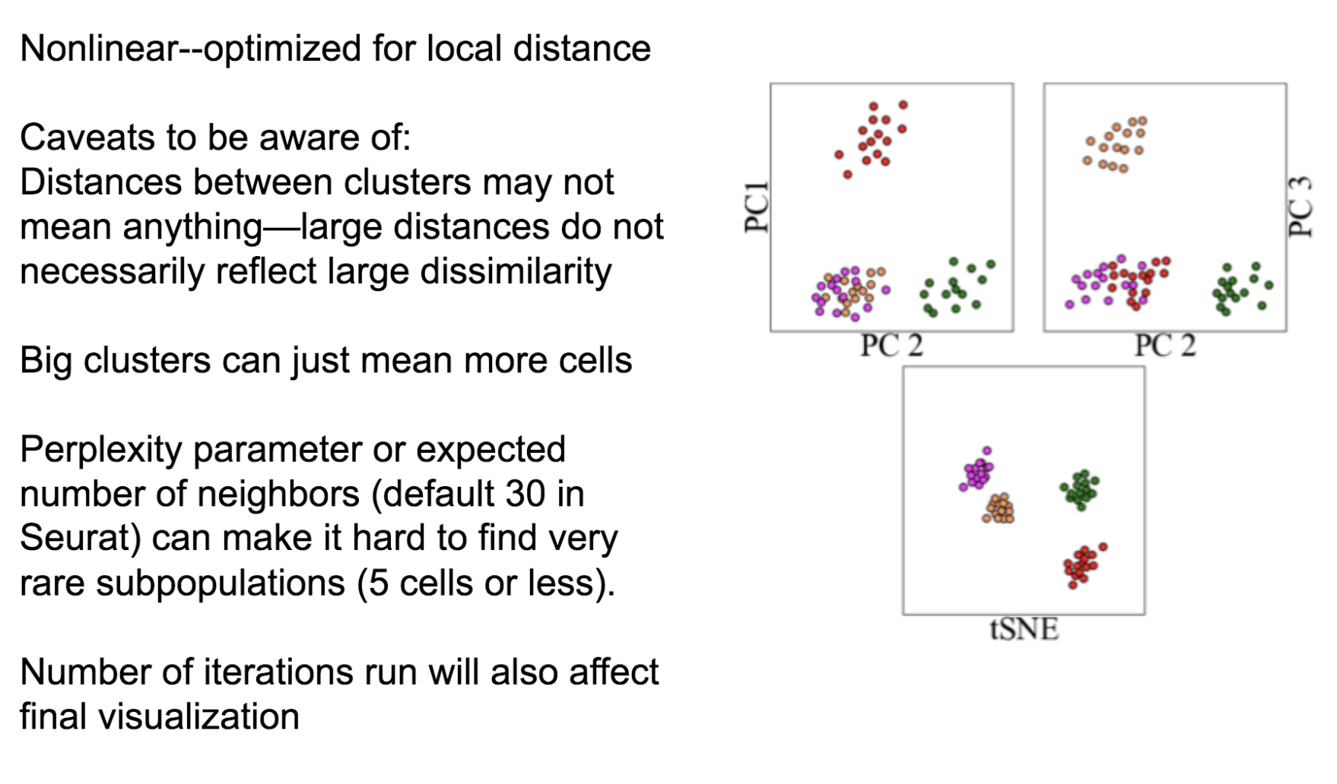
Caution with tSNE visualization
A great tSNE resource! https://distill.pub/2016/misread-tsne/
12
Notes:
I would like to expand these observations to in vivo data. I also want to check what happens in terms of transcriptional dynamics in cells where Cyclin O, a key non-canonical cyclin involved in MCC diff., is knocked-out.

Slide 13
Caution with tSNE visualization
A great tSNE resource! https://distill.pub/2016/misread-tsne/
13
Notes:
I would like to expand these observations to in vivo data. I also want to check what happens in terms of transcriptional dynamics in cells where Cyclin O, a key non-canonical cyclin involved in MCC diff., is knocked-out.

Slide 14
Other non-linear dimensional reduction approaches
Force-directed graph embedding
UMAP
Diffusion Maps
Non-negative Matrix Factorization
Probabilistic (topic models/Latent Dirichlet Allocation (LDA))
BE AWARE!!
Some are linear, some other are not.
While PCA is a general “one-size-fits-all” approach, others will yield more specific outputs, targeting a particular question.
14
Notes:
I would like to expand these observations to in vivo data. I also want to check what happens in terms of transcriptional dynamics in cells where Cyclin O, a key non-canonical cyclin involved in MCC diff., is knocked-out.

Slide 15
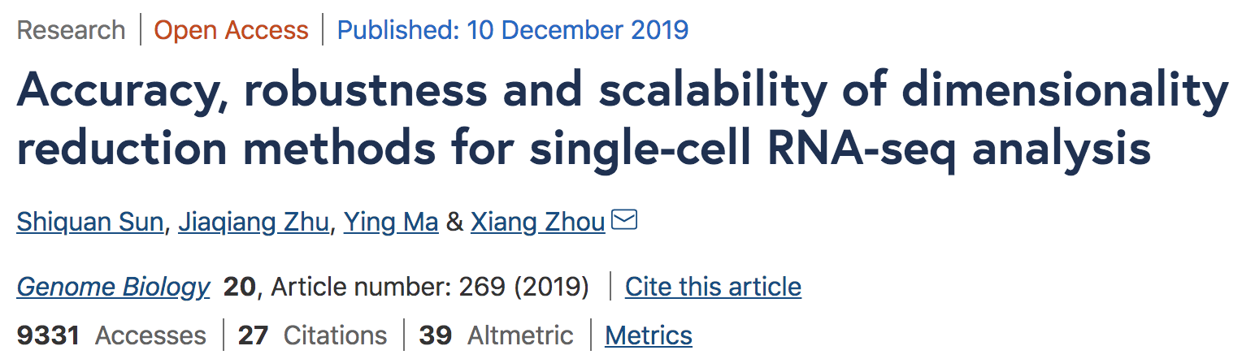
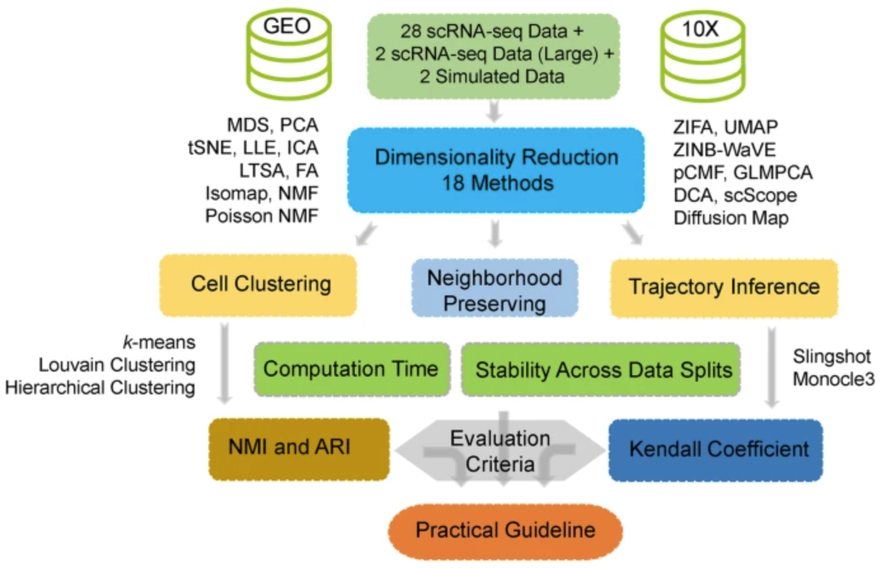
Other non-linear dimensional reduction approaches
15
Notes:
I would like to expand these observations to in vivo data. I also want to check what happens in terms of transcriptional dynamics in cells where Cyclin O, a key non-canonical cyclin involved in MCC diff., is knocked-out.

Slide 16
Analysis workflow
Pre-Processing
Clustering
Biology
Expression Matrix
(GENES x CELLS)
1. Identify
Variable Genes
5. Differentially Expressed Genes
Filter Cells /
Quality Control
2. Dimensionality Reduction
6. Assigning
Cell Type
Normalization
3. Clustering
7. Functional Annotation
4. Explore (known)
marker genes
Notes:
I would like to expand these observations to in vivo data. I also want to check what happens in terms of transcriptional dynamics in cells where Cyclin O, a key non-canonical cyclin involved in MCC diff., is knocked-out.

Slide 17
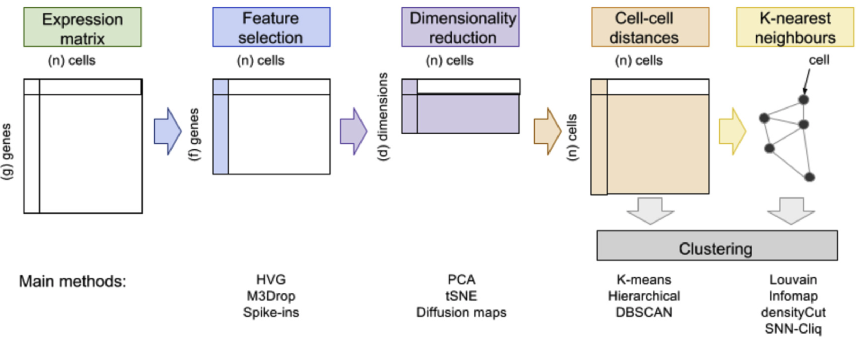
Different methodologies for clustering
Andrews et al., 2018
17
Notes:
I would like to expand these observations to in vivo data. I also want to check what happens in terms of transcriptional dynamics in cells where Cyclin O, a key non-canonical cyclin involved in MCC diff., is knocked-out.

Slide 18
”Traditional” clustering
Andrews et al., 2018
18
Notes:
I would like to expand these observations to in vivo data. I also want to check what happens in terms of transcriptional dynamics in cells where Cyclin O, a key non-canonical cyclin involved in MCC diff., is knocked-out.

Slide 19
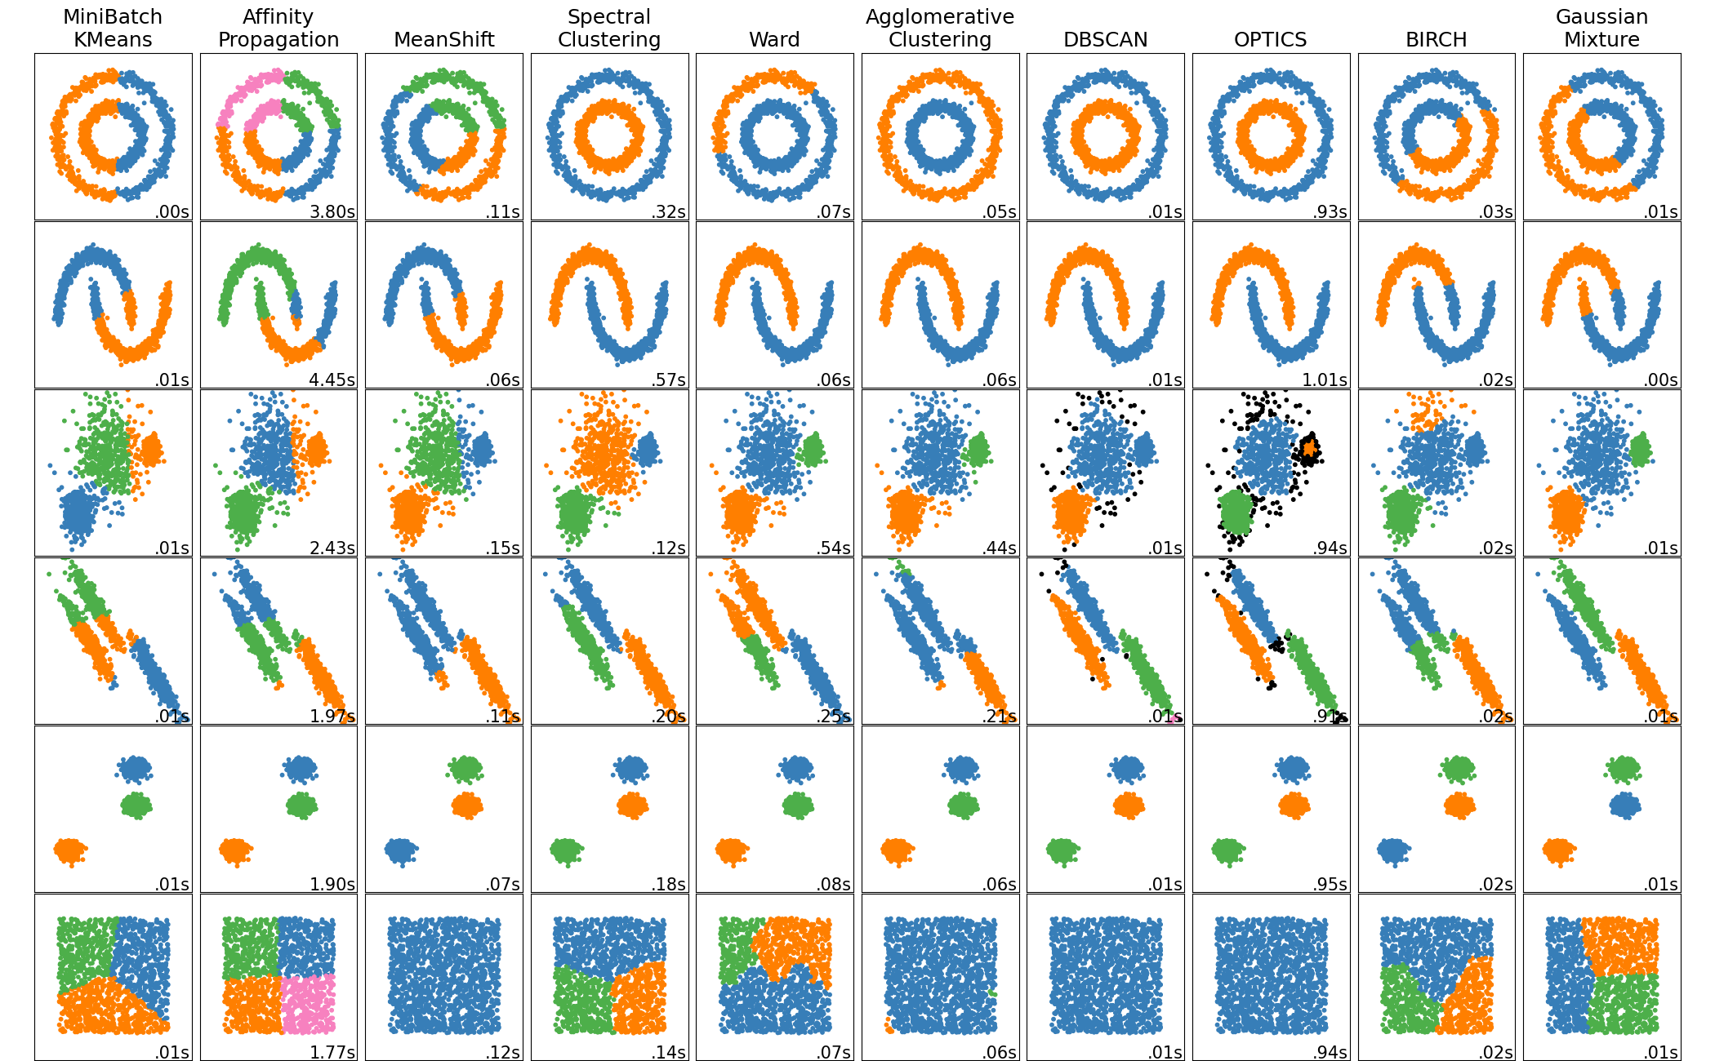
”Traditional” clustering
https://scikit-learn.org/stable/modules/clustering.html#overview-of-clustering-methods
19
Notes:
I would like to expand these observations to in vivo data. I also want to check what happens in terms of transcriptional dynamics in cells where Cyclin O, a key non-canonical cyclin involved in MCC diff., is knocked-out.

Slide 20
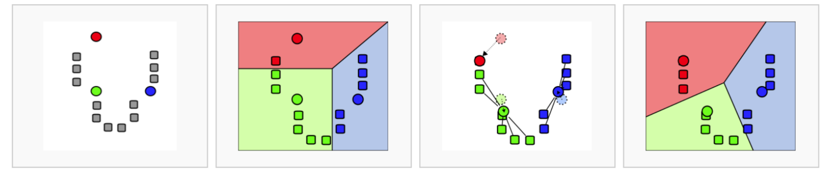
”Traditional” clustering
K-means algorithm is both fast and generally reliable, as a first approach.
20
Notes:
I would like to expand these observations to in vivo data. I also want to check what happens in terms of transcriptional dynamics in cells where Cyclin O, a key non-canonical cyclin involved in MCC diff., is knocked-out.

Slide 21
Graph-based clustering
Andrews et al., 2018
21
Notes:
I would like to expand these observations to in vivo data. I also want to check what happens in terms of transcriptional dynamics in cells where Cyclin O, a key non-canonical cyclin involved in MCC diff., is knocked-out.

Slide 22
Why do we need graph-based clustering?
Curse of dimensionality:
“All data become sparse in high-dimensional space and therefore similarities measured by Euclidean distances etc are generally low between all objects.”
There is no point performing a hierarchical clustering of 10,000 cells if 90% of the pairwise distances are null !!
Andrews et al., 2018
22
Notes:
I would like to expand these observations to in vivo data. I also want to check what happens in terms of transcriptional dynamics in cells where Cyclin O, a key non-canonical cyclin involved in MCC diff., is knocked-out.

Slide 23
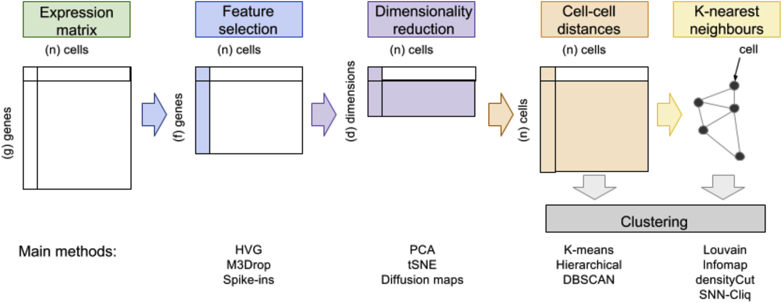

Building a k-Nearest Neighbors graph (with k = 4)
23
Notes:
I would like to expand these observations to in vivo data. I also want to check what happens in terms of transcriptional dynamics in cells where Cyclin O, a key non-canonical cyclin involved in MCC diff., is knocked-out.

Slide 24
Building a k-Nearest Neighbors graph (with k = 4)
1
24
Notes:
I would like to expand these observations to in vivo data. I also want to check what happens in terms of transcriptional dynamics in cells where Cyclin O, a key non-canonical cyclin involved in MCC diff., is knocked-out.

Slide 25
Building a k-Nearest Neighbors graph (with k = 4)
1
2
25
Notes:
I would like to expand these observations to in vivo data. I also want to check what happens in terms of transcriptional dynamics in cells where Cyclin O, a key non-canonical cyclin involved in MCC diff., is knocked-out.

Slide 26
Building a k-Nearest Neighbors graph (with k = 4)
1
3
2
26
Notes:
I would like to expand these observations to in vivo data. I also want to check what happens in terms of transcriptional dynamics in cells where Cyclin O, a key non-canonical cyclin involved in MCC diff., is knocked-out.

Slide 27
Building a k-Nearest Neighbors graph (with k = 4)
4
1
3
2
27
Notes:
I would like to expand these observations to in vivo data. I also want to check what happens in terms of transcriptional dynamics in cells where Cyclin O, a key non-canonical cyclin involved in MCC diff., is knocked-out.

Slide 28
Building a k-Nearest Neighbors graph (with k = 4)
4
1
3
2
4
1
3
2
28
Notes:
I would like to expand these observations to in vivo data. I also want to check what happens in terms of transcriptional dynamics in cells where Cyclin O, a key non-canonical cyclin involved in MCC diff., is knocked-out.

Slide 29
Building a k-Nearest Neighbors graph (with k = 4)
29
Notes:
I would like to expand these observations to in vivo data. I also want to check what happens in terms of transcriptional dynamics in cells where Cyclin O, a key non-canonical cyclin involved in MCC diff., is knocked-out.

Slide 30
Extending KNN to SNN graphs (Shared Nearest Neighbors) (still with k = 4)
30
Notes:
I would like to expand these observations to in vivo data. I also want to check what happens in terms of transcriptional dynamics in cells where Cyclin O, a key non-canonical cyclin involved in MCC diff., is knocked-out.

Slide 31
Extending KNN to SNN graphs (Shared Nearest Neighbors) (still with k = 4)
Two cells are connected by an edge if any of their nearest neighbors are shared.
31
Notes:
I would like to expand these observations to in vivo data. I also want to check what happens in terms of transcriptional dynamics in cells where Cyclin O, a key non-canonical cyclin involved in MCC diff., is knocked-out.

Slide 32
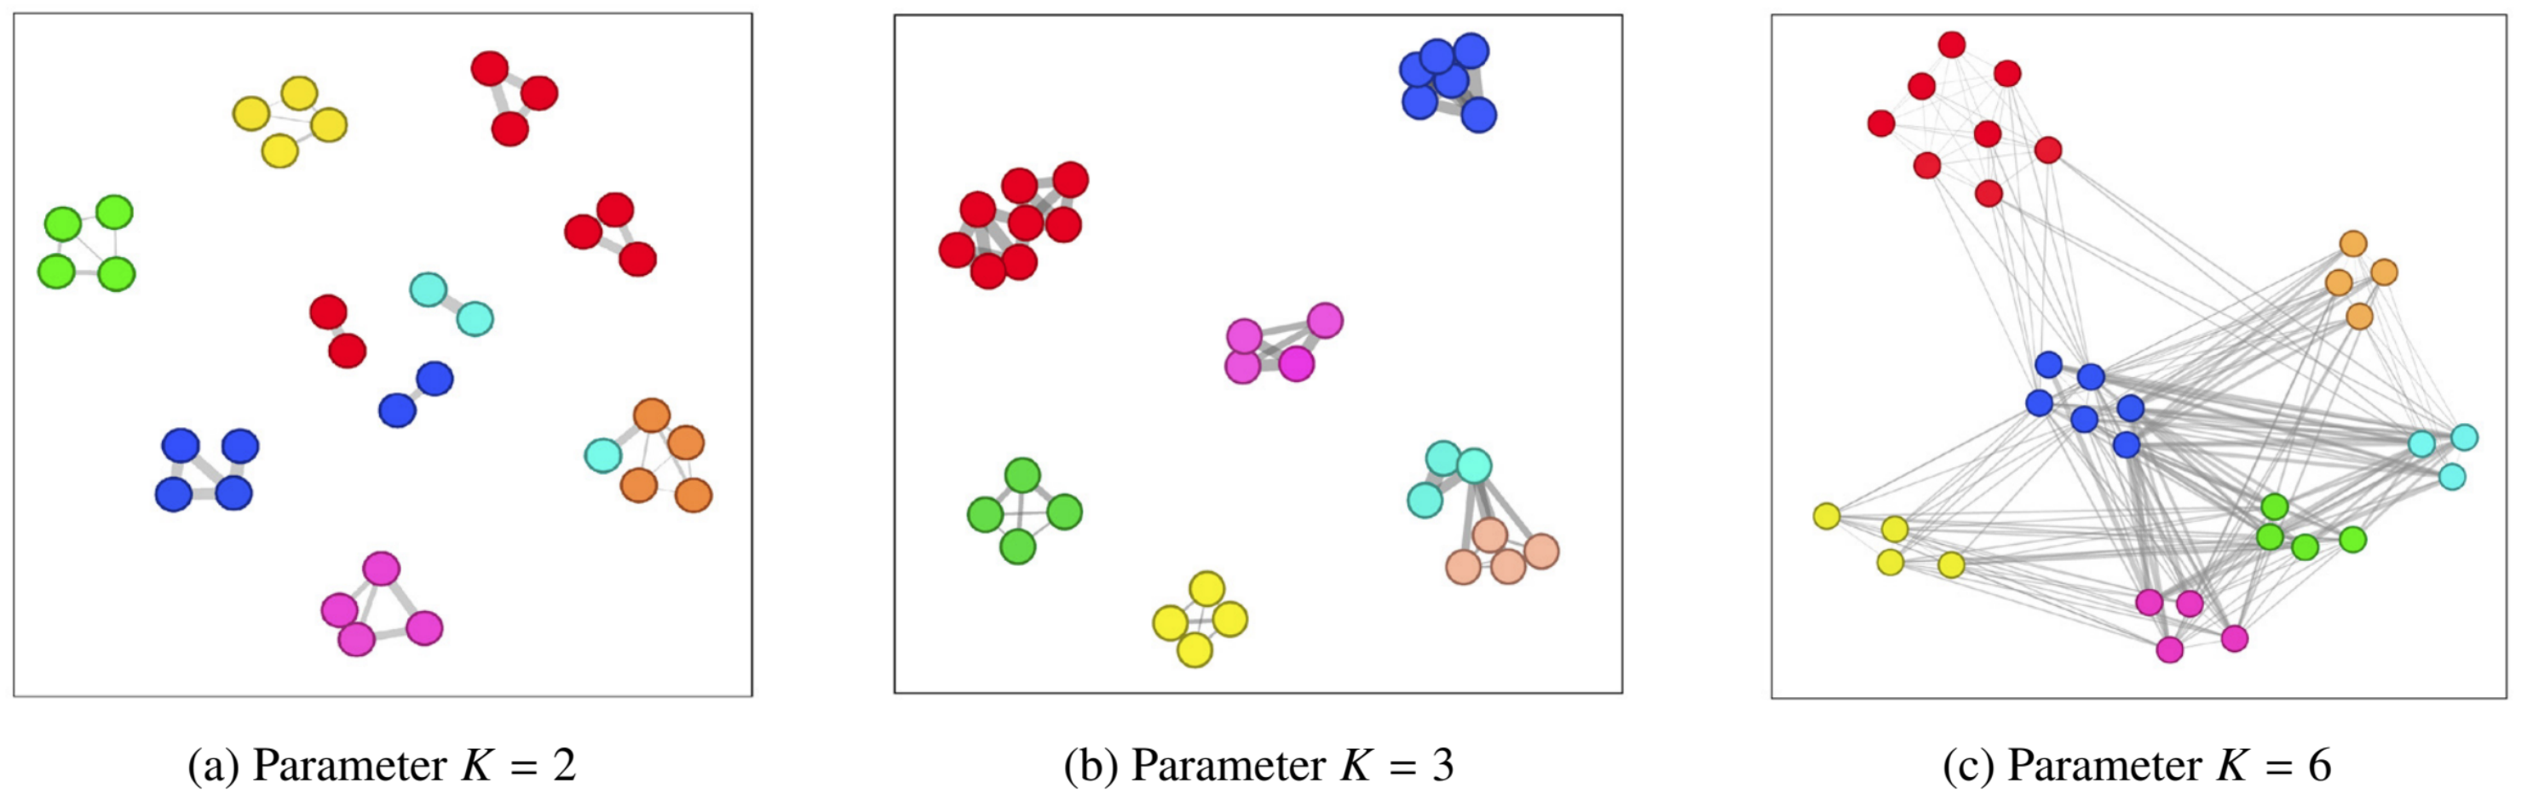
Extending KNN to SNN graphs (Shared Nearest Neighbors) (still with k = 4)
K is important when building KNN or SNN graphs !
32
Notes:
I would like to expand these observations to in vivo data. I also want to check what happens in terms of transcriptional dynamics in cells where Cyclin O, a key non-canonical cyclin involved in MCC diff., is knocked-out.

Slide 33
Graph-based clustering
Graph-based clustering is nothing more than community detection (an “old” field from ’00s).
33
Notes:
I would like to expand these observations to in vivo data. I also want to check what happens in terms of transcriptional dynamics in cells where Cyclin O, a key non-canonical cyclin involved in MCC diff., is knocked-out.

Slide 34
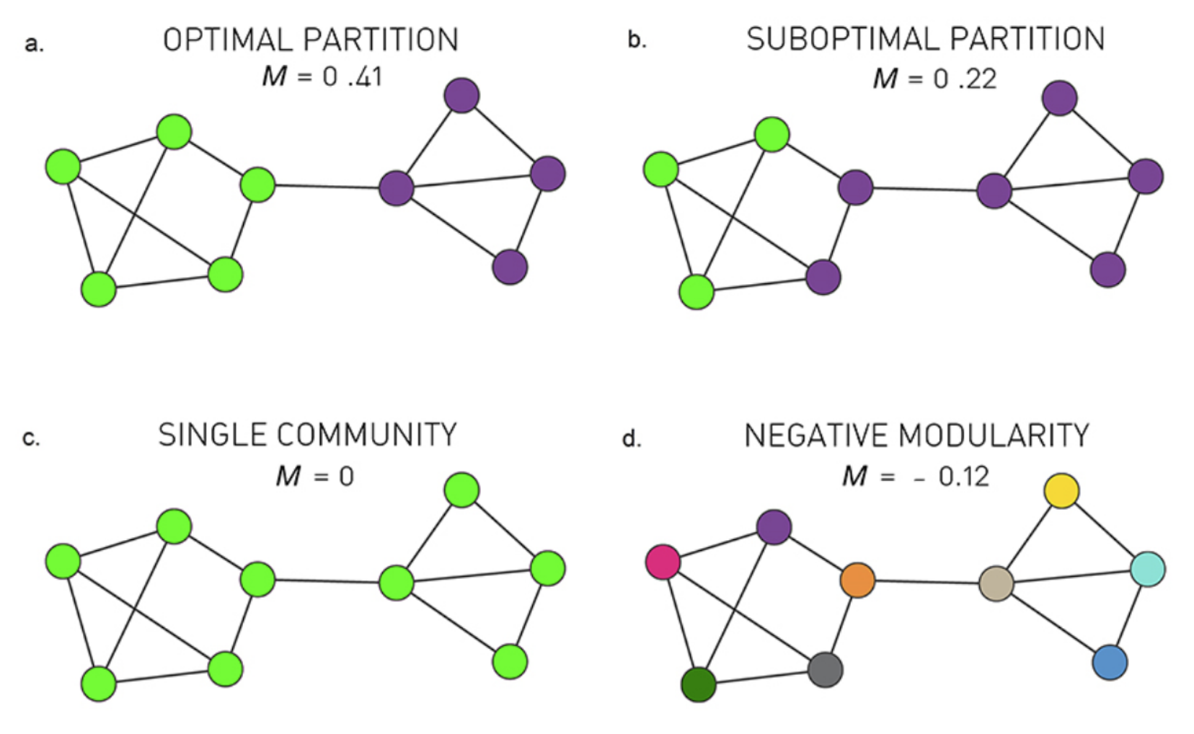
Graph-based clustering
Graph-based clustering is nothing more than community detection (an “old” field from ’00s).
Many different algorithms for community detection:
Louvain (heuristic)
Infomap
Walktrap
…
Most of them are based on modularity maximization
34
Notes:
I would like to expand these observations to in vivo data. I also want to check what happens in terms of transcriptional dynamics in cells where Cyclin O, a key non-canonical cyclin involved in MCC diff., is knocked-out.

Slide 35

Graph-based clustering
Graph-based clustering is nothing more than community detection (an “old” field from ’00s).
The Atlas for the Aspiring Network Scientist,
Michele Coscia 2021
35
Notes:
I would like to expand these observations to in vivo data. I also want to check what happens in terms of transcriptional dynamics in cells where Cyclin O, a key non-canonical cyclin involved in MCC diff., is knocked-out.

Slide 36
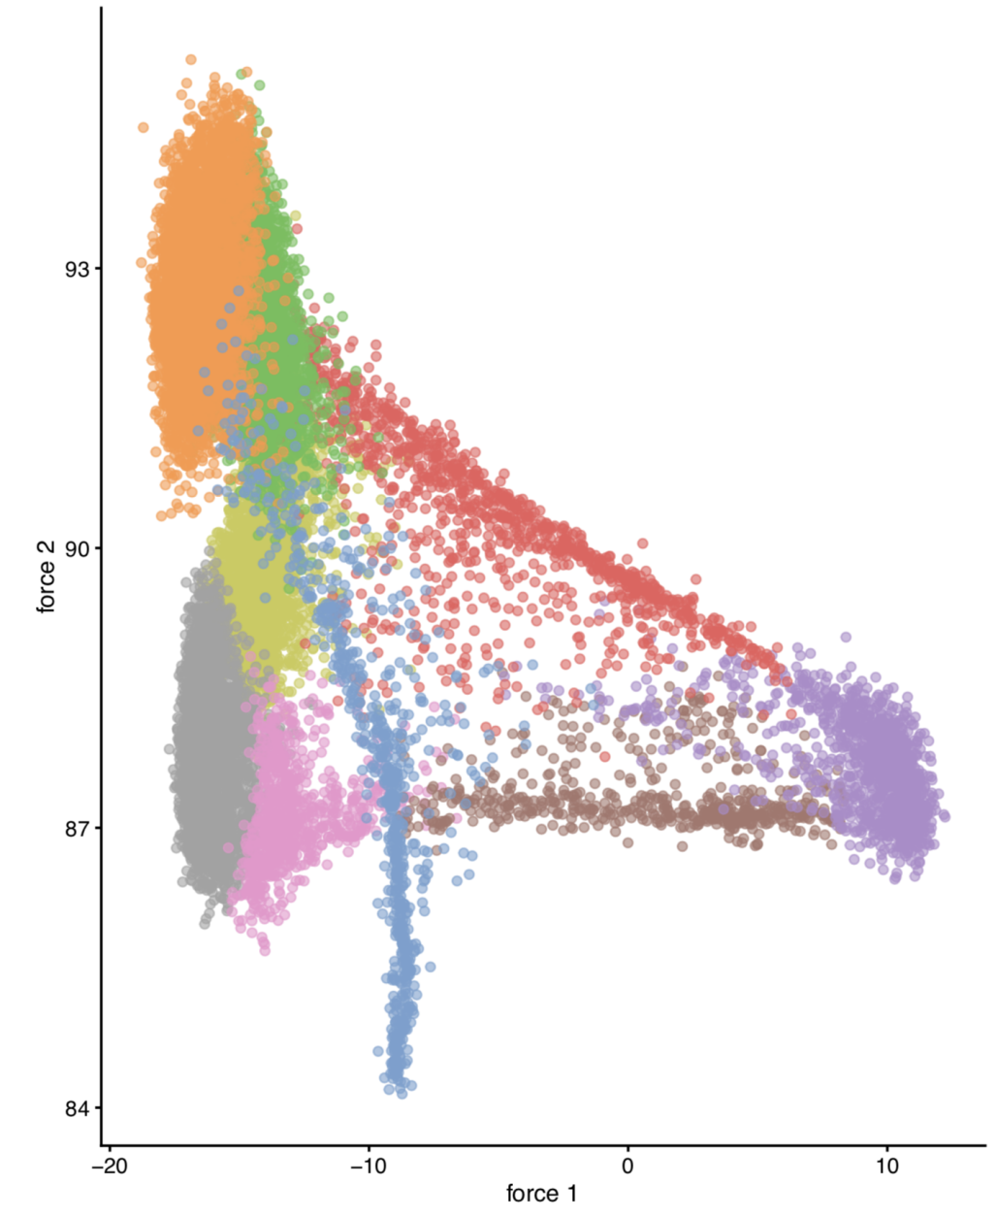
Graph-based clustering
CAREFUL!
A graph can be visualized (i.e. embedded) in 2D, but the graph-based clustering step (i.e. community finding) is not done on its 2D embedding!!
“Do not let the tail (of visualization) wag the dog (of quantitative analysis)”
-- A. Lun
36
Notes:
I would like to expand these observations to in vivo data. I also want to check what happens in terms of transcriptional dynamics in cells where Cyclin O, a key non-canonical cyclin involved in MCC diff., is knocked-out.

Slide 37
Analysis workflow
Pre-Processing
Clustering
Biology
Expression Matrix
(GENES x CELLS)
1. Identify
Variable Genes
5. Differentially Expressed Genes
Filter Cells /
Quality Control
2. Dimensionality Reduction
6. Assigning
Cell Type
Normalization
3. Clustering
7. Functional Annotation
4. Explore (known)
marker genes
Notes:
I would like to expand these observations to in vivo data. I also want to check what happens in terms of transcriptional dynamics in cells where Cyclin O, a key non-canonical cyclin involved in MCC diff., is knocked-out.

Slide 38
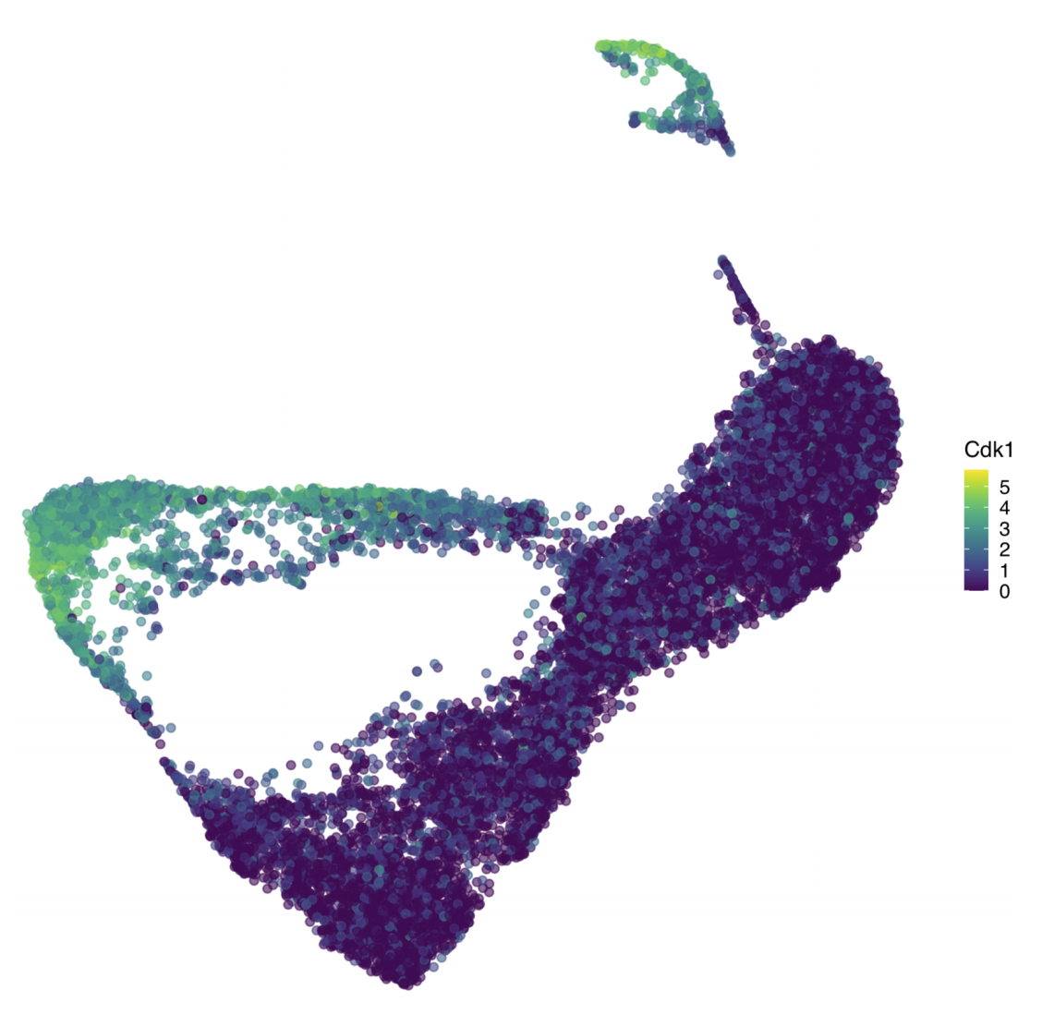
Visualizing expression of a gene of interest
On the dataset embedding:
38
Notes:
I would like to expand these observations to in vivo data. I also want to check what happens in terms of transcriptional dynamics in cells where Cyclin O, a key non-canonical cyclin involved in MCC diff., is knocked-out.

Slide 39
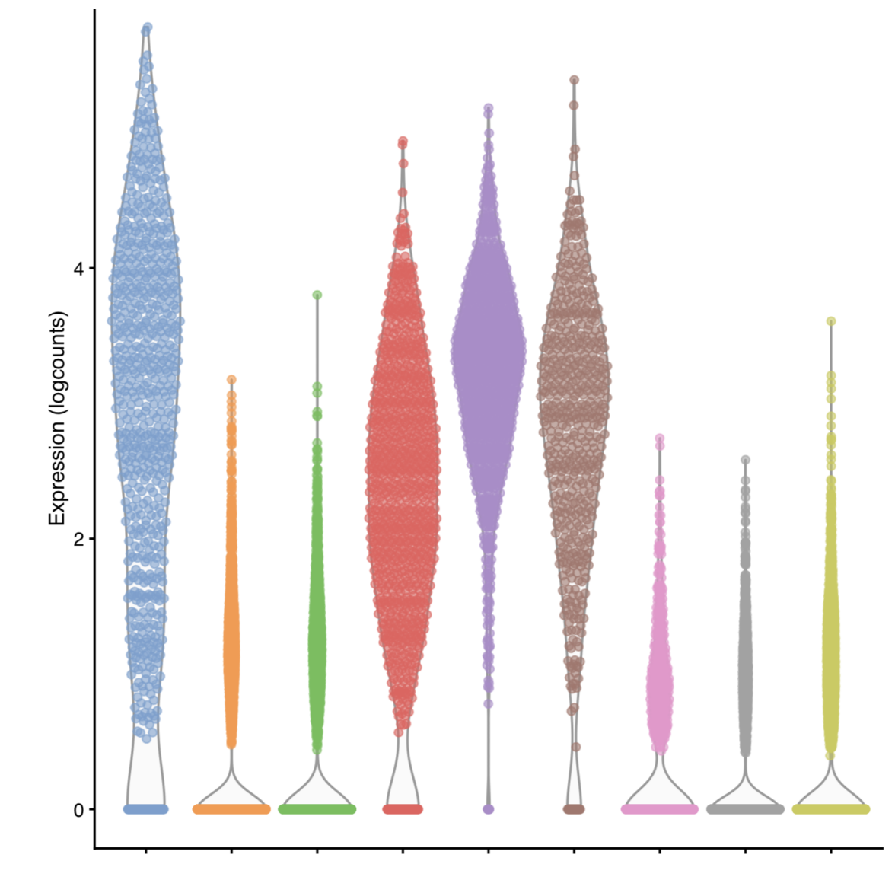
Visualizing expression of a gene of interest
On the dataset embedding:
By clusters:
39
Notes:
I would like to expand these observations to in vivo data. I also want to check what happens in terms of transcriptional dynamics in cells where Cyclin O, a key non-canonical cyclin involved in MCC diff., is knocked-out.

Slide 40
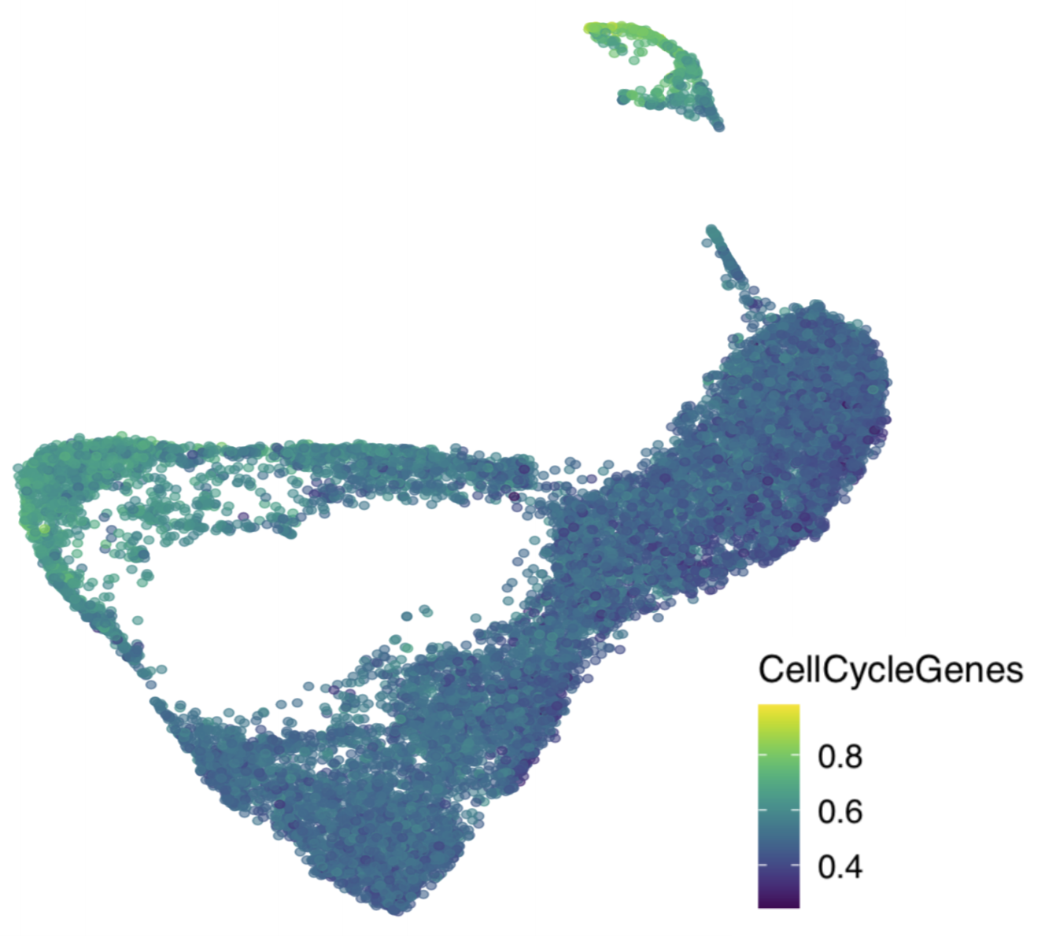
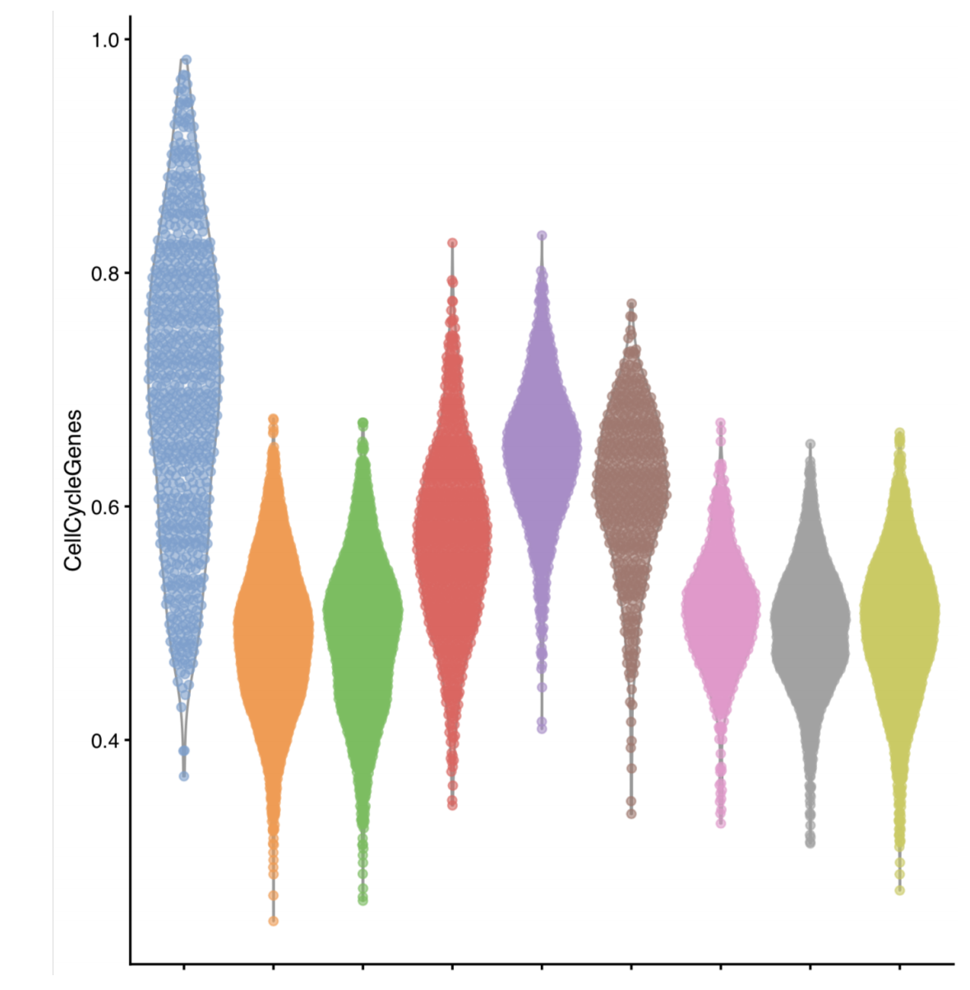
Visualizing expression of a module of interest
On the dataset embedding:
By clusters:
40
Notes:
I would like to expand these observations to in vivo data. I also want to check what happens in terms of transcriptional dynamics in cells where Cyclin O, a key non-canonical cyclin involved in MCC diff., is knocked-out.

Slide 41
Analysis workflow
Pre-Processing
Clustering
Biology
Expression Matrix
(GENES x CELLS)
1. Identify
Variable Genes
5. Differentially Expressed Genes
Filter Cells /
Quality Control
2. Dimensionality Reduction
6. Assigning
Cell Type
Normalization
3. Clustering
7. Functional Annotation
4. Explore (known)
marker genes
Notes:
I would like to expand these observations to in vivo data. I also want to check what happens in terms of transcriptional dynamics in cells where Cyclin O, a key non-canonical cyclin involved in MCC diff., is knocked-out.

Slide 42
Differential Expression Testing
In scRNA-seq we often do not have a defined set of experimental conditions.
Instead, we can perform pairwise comparisons of gene expression, between pairs of cell clusters, using some of the following tests:
"wilcox" : Wilcoxon rank sum test (default)
t" : Student’s t-test
"poisson" : Likelihood ratio test assuming an underlying poisson distribution. Use only for UMI-based datasets
"negbinom" : Likelihood ratio test assuming an underlying negative binomial distribution. Use only for UMI-based datasets
Others…
42
Notes:
I would like to expand these observations to in vivo data. I also want to check what happens in terms of transcriptional dynamics in cells where Cyclin O, a key non-canonical cyclin involved in MCC diff., is knocked-out.

Slide 43
Differential Expression Testing
In scRNA-seq we often do not have a defined set of experimental conditions.
Instead, we can perform pairwise comparisons of gene expression, between pairs of cell clusters, using some of the following tests:
See Seurat::FindMarkers() and scran::findMarkers() for more info…
markers <- scran::findMarkers(
sce,
groups = sce$cluster,
test.type = ”t”
)
43
Notes:
I would like to expand these observations to in vivo data. I also want to check what happens in terms of transcriptional dynamics in cells where Cyclin O, a key non-canonical cyclin involved in MCC diff., is knocked-out.

Slide 44

Differential Expression Testing
Think about your experimental design!!!
BACKGROUND
N genes
N reads
BATCH
RUN
1,000s cells
44
Notes:
I would like to expand these observations to in vivo data. I also want to check what happens in terms of transcriptional dynamics in cells where Cyclin O, a key non-canonical cyclin involved in MCC diff., is knocked-out.

Slide 45
Differential Expression Testing
Think about your experimental design!!!
BACKGROUND
N genes
N reads
BATCH
RUN
1,000s cells
Not all the cells are the same: there are confounding variables.
45
Notes:
I would like to expand these observations to in vivo data. I also want to check what happens in terms of transcriptional dynamics in cells where Cyclin O, a key non-canonical cyclin involved in MCC diff., is knocked-out.

Slide 46
Differential Expression Testing
Think about your experimental design!!!
BACKGROUND
N genes
N reads
BATCH
RUN
1,000s cells
BLOCKING MATRIX
Not all the cells are the same: there are confounding variables.
markers <- scran::findMarkers(
sce,
groups = sce$cluster,
test.type = ”t”,
block = <BLOCKING MATRIX>
)
46
Notes:
I would like to expand these observations to in vivo data. I also want to check what happens in terms of transcriptional dynamics in cells where Cyclin O, a key non-canonical cyclin involved in MCC diff., is knocked-out.

Slide 47
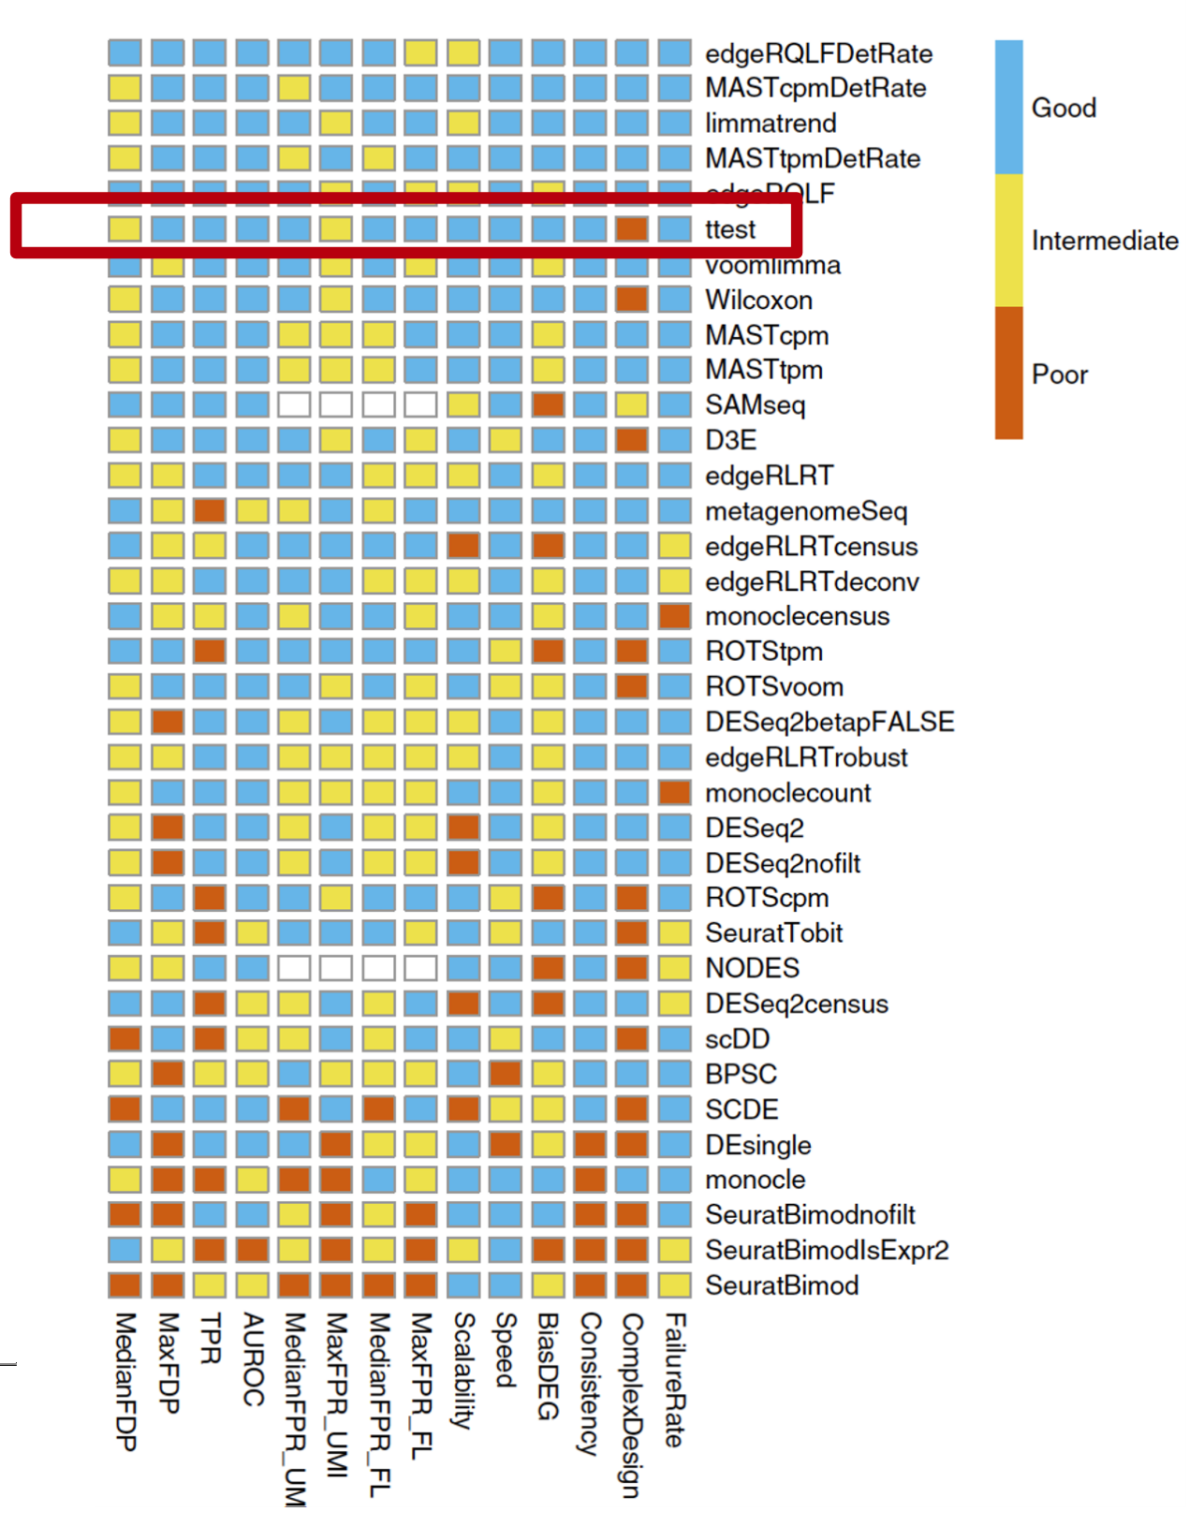
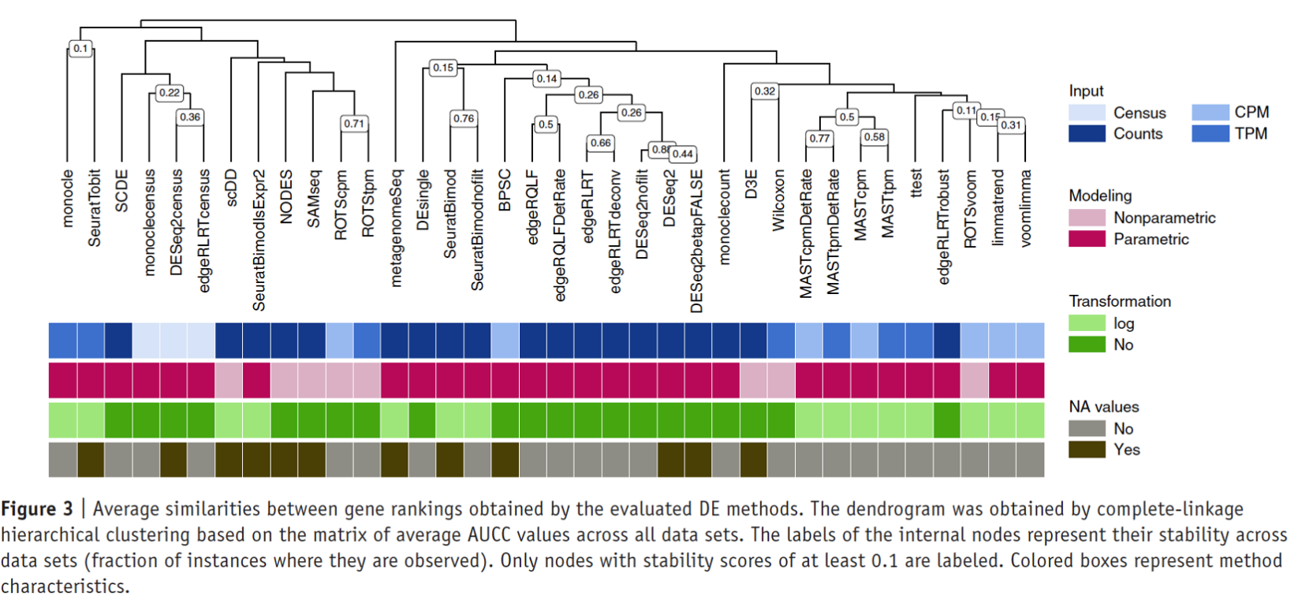
Differential Expression Testing: many different assays…
Again, different tests are available and depending on your study case, might be more/less appropriate.
I would recommend going with t-test as default.
Soneson and Robinson, 2018
47
Notes:
I would like to expand these observations to in vivo data. I also want to check what happens in terms of transcriptional dynamics in cells where Cyclin O, a key non-canonical cyclin involved in MCC diff., is knocked-out.

Slide 48
Analysis workflow
Pre-Processing
Clustering
Biology
Expression Matrix
(GENES x CELLS)
1. Identify
Variable Genes
5. Differentially Expressed Genes
Filter Cells /
Quality Control
2. Dimensionality Reduction
6. Assigning
Cell Type
Normalization
3. Clustering
7. Functional Annotation
4. Explore (known)
marker genes
Notes:
I would like to expand these observations to in vivo data. I also want to check what happens in terms of transcriptional dynamics in cells where Cyclin O, a key non-canonical cyclin involved in MCC diff., is knocked-out.

Slide 49
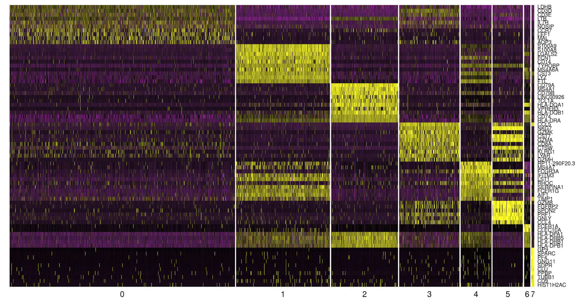
Cell type annotation using identified markers per cluster
Genes
Cell clusters
49
Notes:
I would like to expand these observations to in vivo data. I also want to check what happens in terms of transcriptional dynamics in cells where Cyclin O, a key non-canonical cyclin involved in MCC diff., is knocked-out.

Slide 50
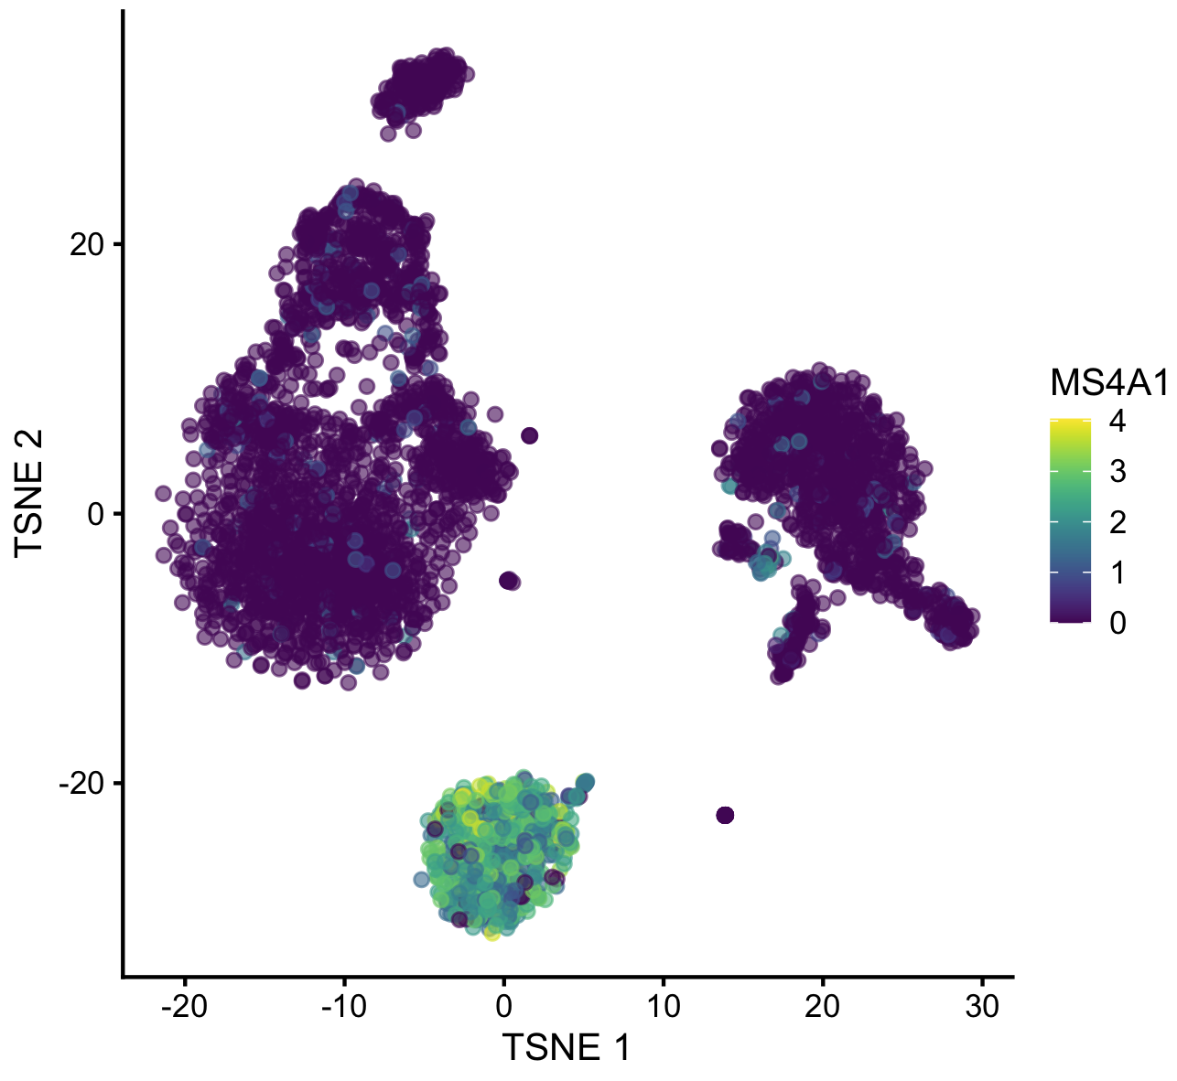
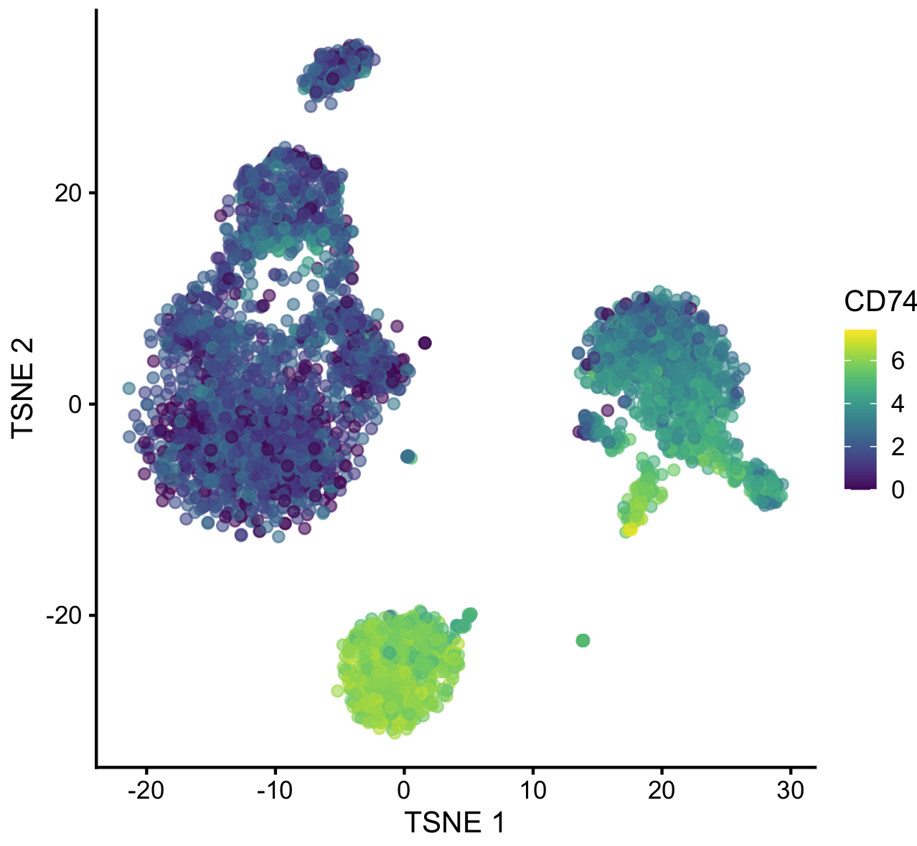
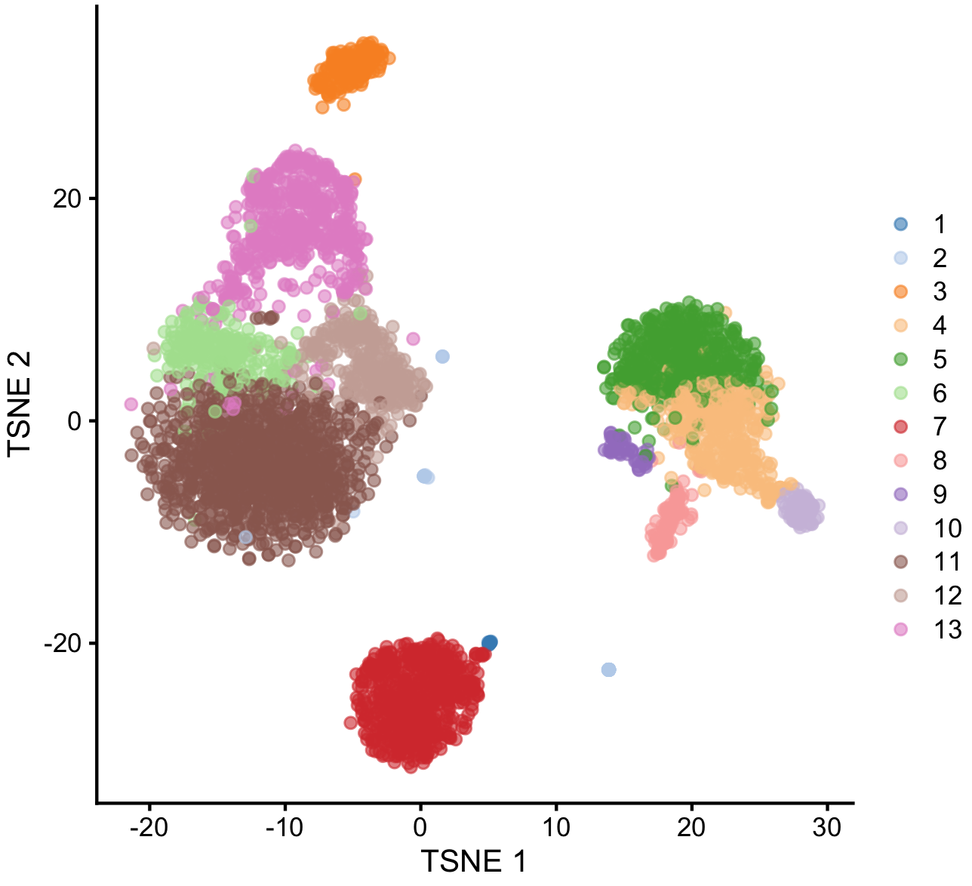
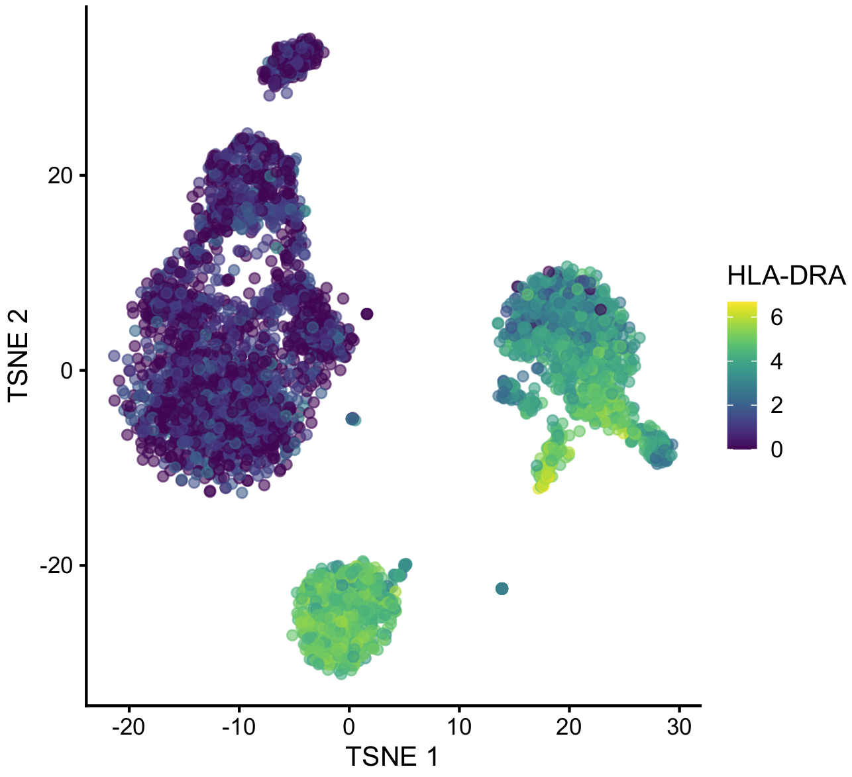

Manual cell type annotation using identified markers per cluster
Top markers of cluster #7 in PBMCs:
CD74
HLA-DRA
MS4A1
CD79A
HLA-DRB1
HLA-DPA1
CD79B
LTB
HLA-DQB1
TCL1A
CD52
HLA-DPB1
CD37
50
Notes:
I would like to expand these observations to in vivo data. I also want to check what happens in terms of transcriptional dynamics in cells where Cyclin O, a key non-canonical cyclin involved in MCC diff., is knocked-out.

Slide 51
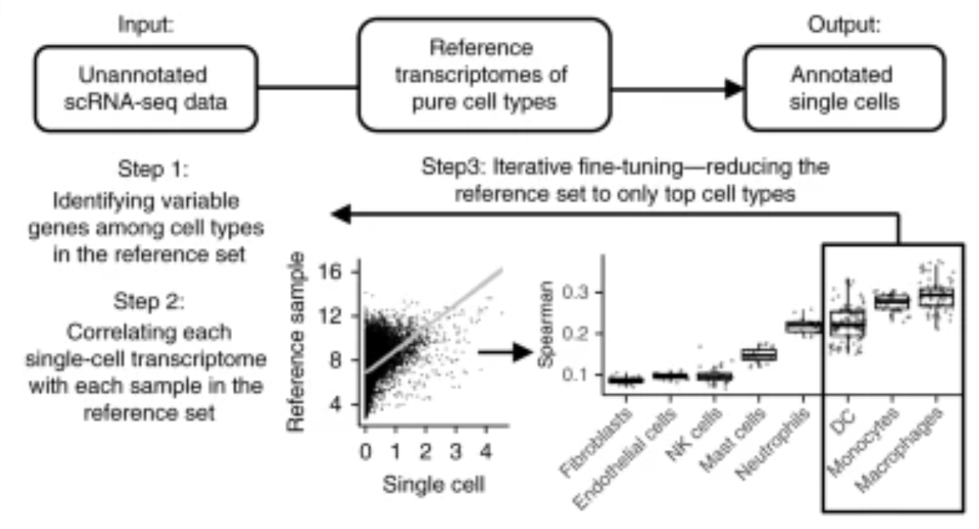
Automated cell type annotation using public marker databases
SingleR can rely on references of pure cell types to annotate individual cells within a scRNAseq dataset.
Aran et al., Nat. Immuno. 2019
51
Notes:
I would like to expand these observations to in vivo data. I also want to check what happens in terms of transcriptional dynamics in cells where Cyclin O, a key non-canonical cyclin involved in MCC diff., is knocked-out.

Slide 52
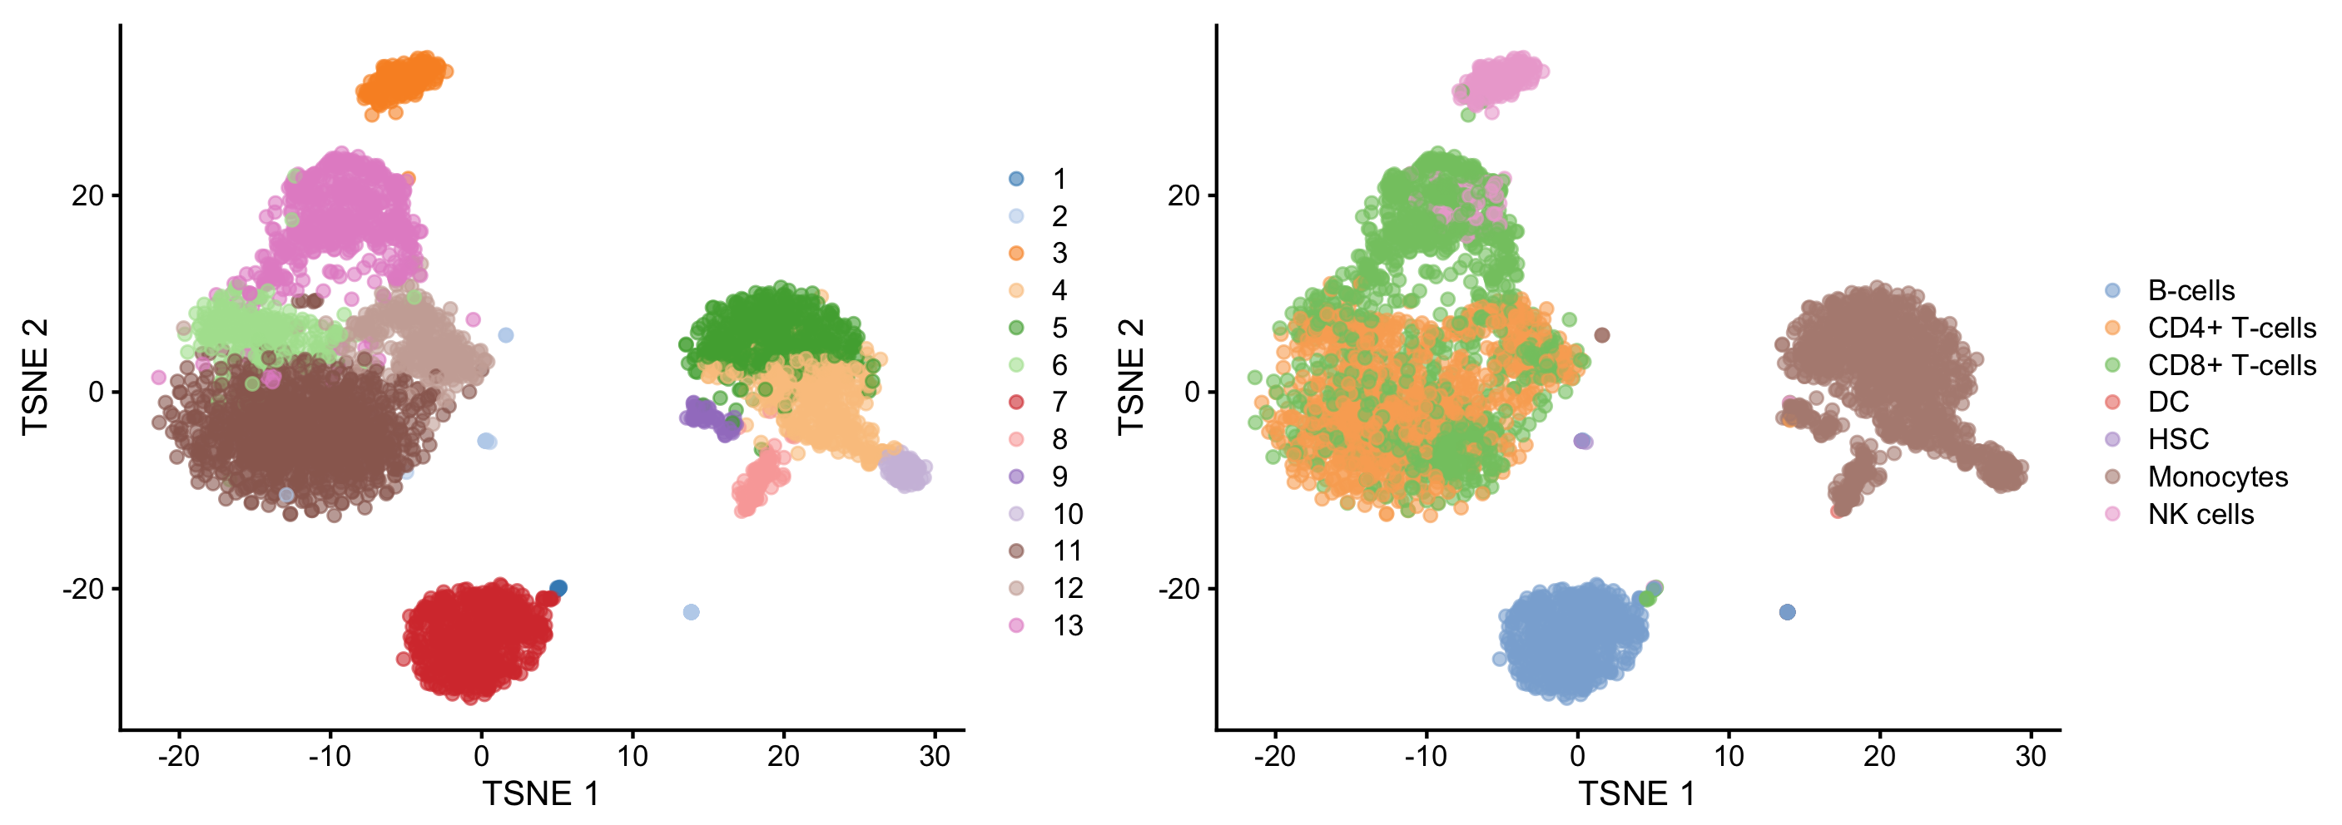
Automated cell type annotation using public marker databases
SingleR can rely on references of pure cell types to annotate individual cells within a scRNAseq dataset.
However, it is limited in sensitivity, as it can only identify cells based on the references used.
52
Notes:
I would like to expand these observations to in vivo data. I also want to check what happens in terms of transcriptional dynamics in cells where Cyclin O, a key non-canonical cyclin involved in MCC diff., is knocked-out.

Slide 53
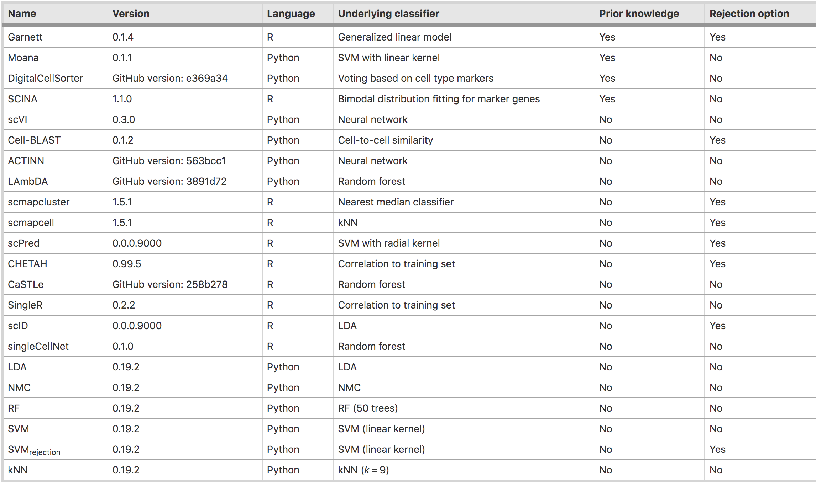
Automated cell type annotation using public marker databases
Huge (and growing!) collection of tools for automated cell annotation…
Abdelaal et al., Genome Biol. 2019
53
Notes:
I would like to expand these observations to in vivo data. I also want to check what happens in terms of transcriptional dynamics in cells where Cyclin O, a key non-canonical cyclin involved in MCC diff., is knocked-out.

Slide 54
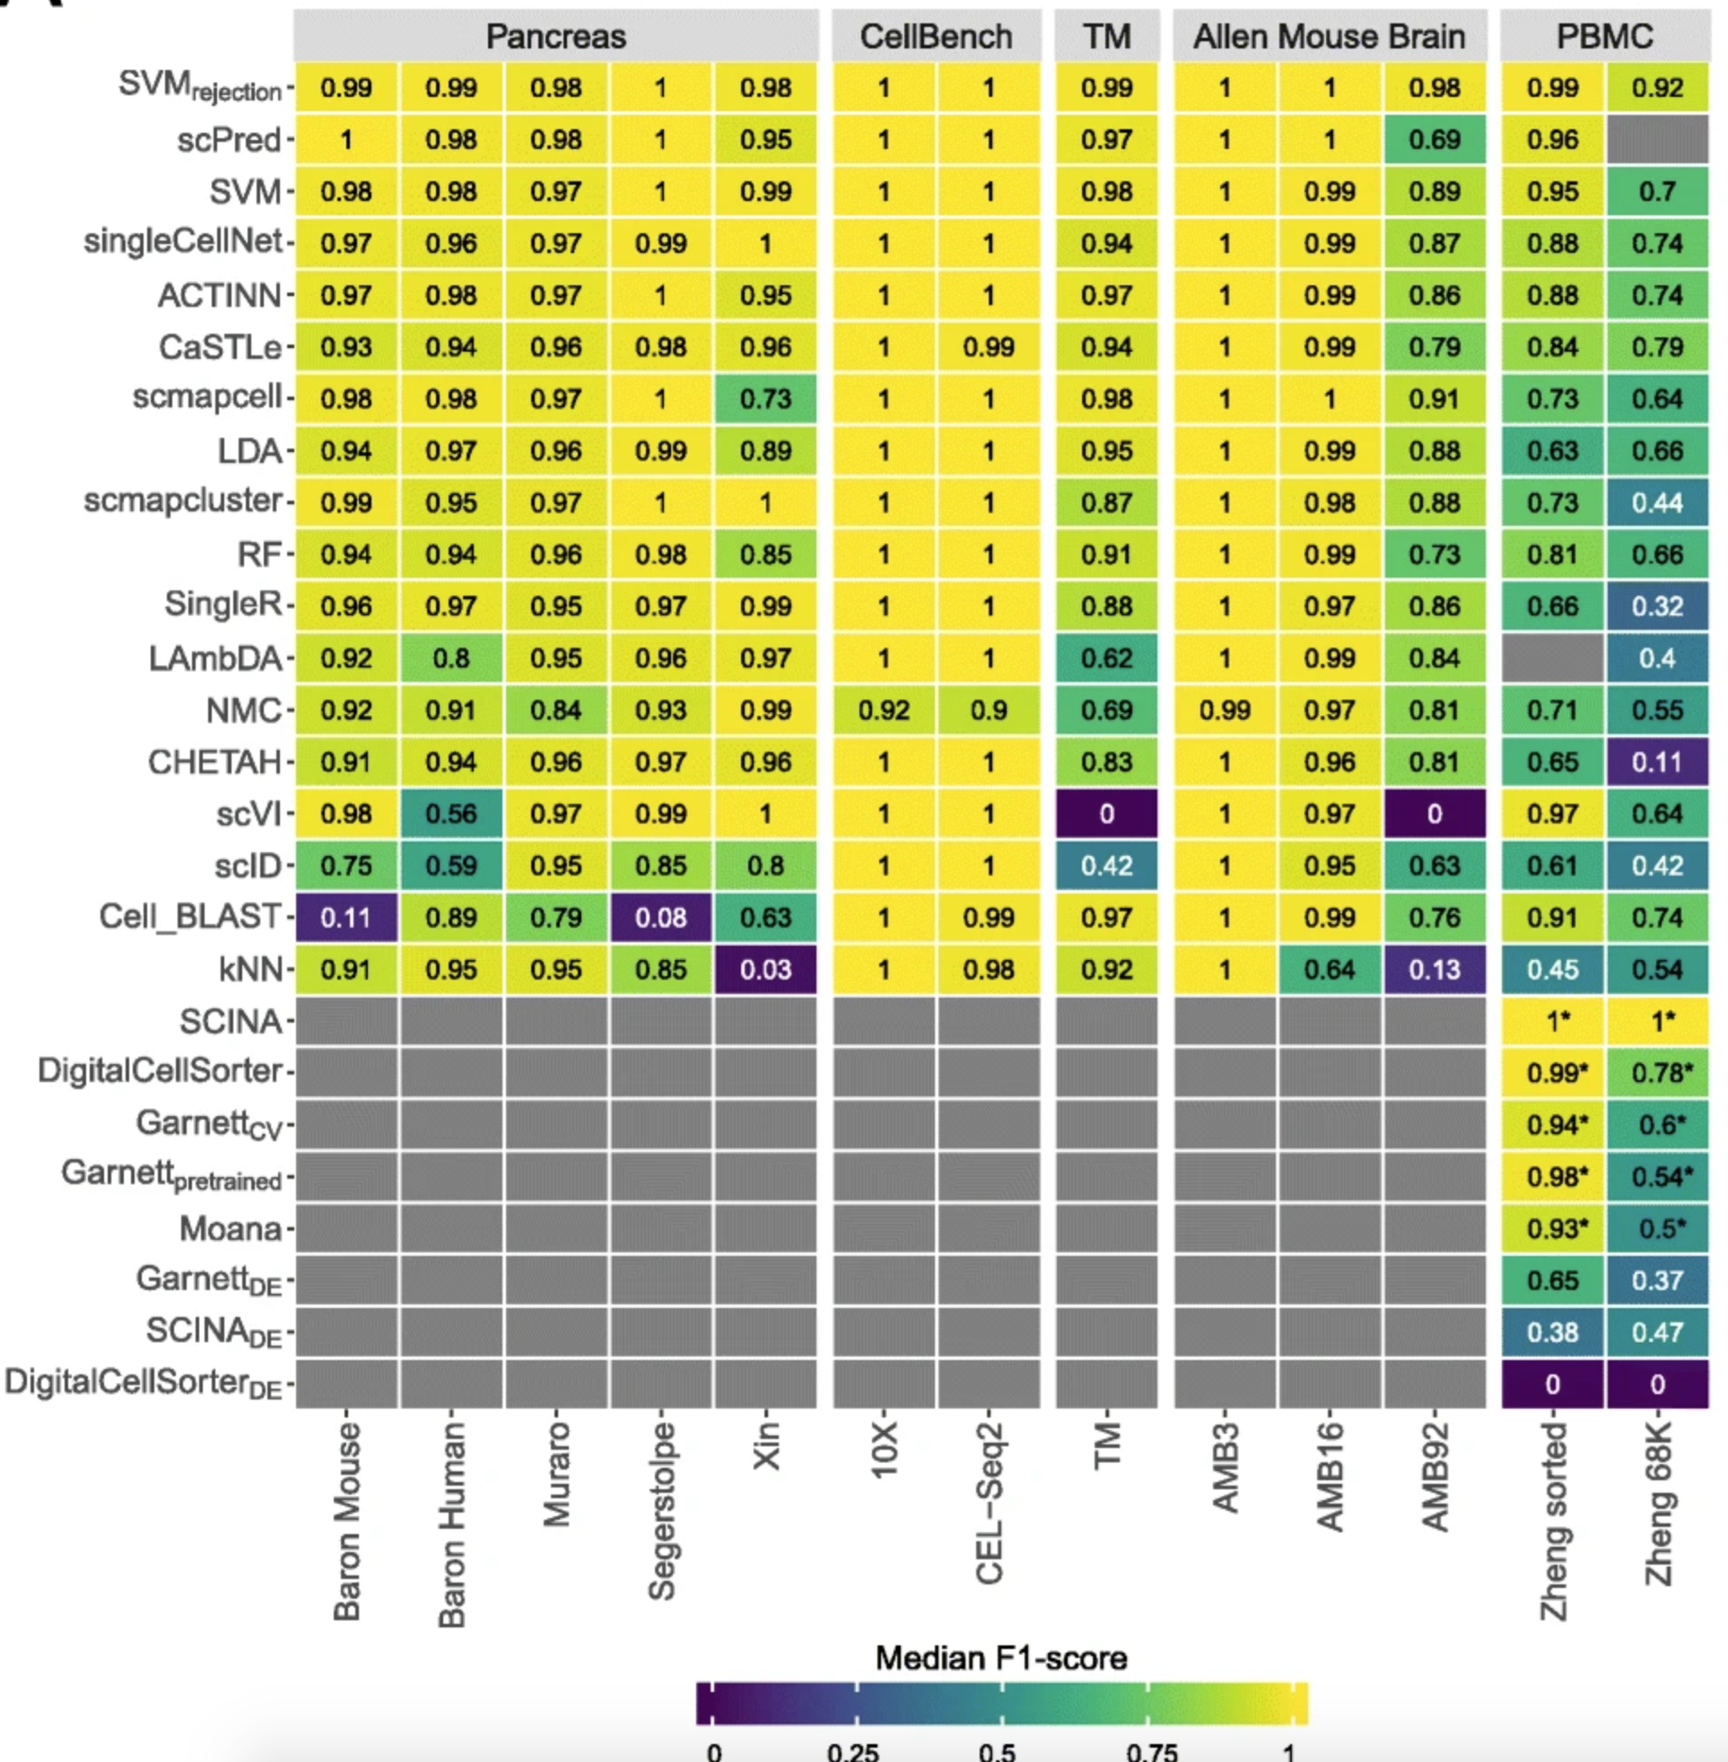
Automated cell type annotation using public marker databases
Huge (and growing!) collection of tools for automated cell annotation…
Abdelaal et al., Genome Biol. 2019
54
Notes:
I would like to expand these observations to in vivo data. I also want to check what happens in terms of transcriptional dynamics in cells where Cyclin O, a key non-canonical cyclin involved in MCC diff., is knocked-out.

